Slide 1
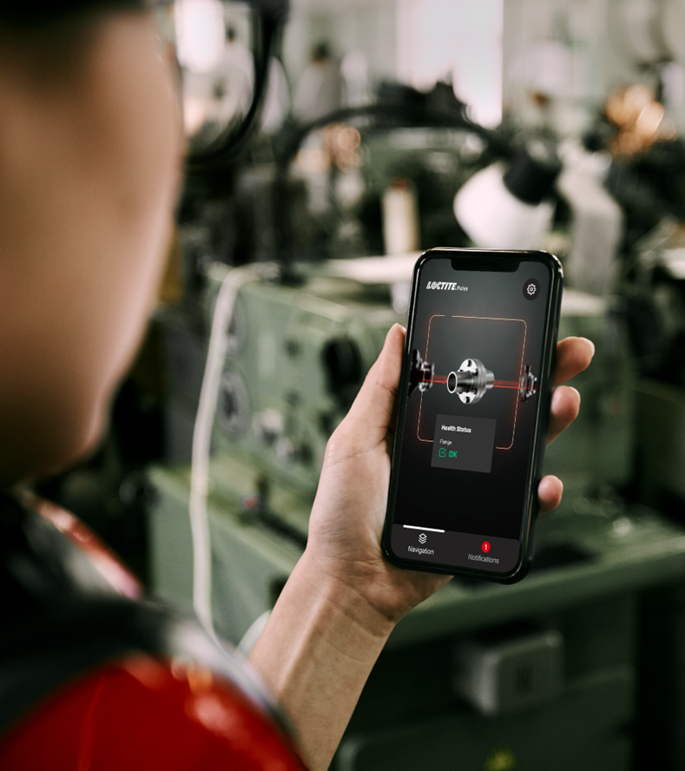
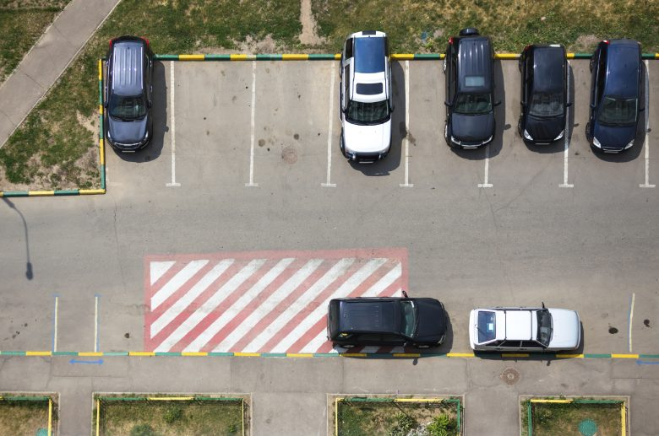

Parking space availability Predictor
Sharan nandkumar, 5th August 2024
Predict

Slide 2

AGENDA
Problem Statement
Project Goal
Assumptions/Exclusions.
High level Implementation Plan
ML Model Chosen – CATBoost
Performance Metric – MAE
Model Evaluation for both locations
Average Utilization Rates: HBF vs. SB
Occupancy for February 1, 2022
Occupancy for April 15, 2022
Factors Effecting Parking Spaces
Future Scope Data Collection
APP demonstration
Q&A

Slide 3


Problem statement
Dream Inc. aims to enhance the vehicle parking experience in Freiburg by developing a predictive app that forecasts parking availability. Users seek to:
Obtain predictions for the number of available parking slots for a selected location, date, and time.
Understand the factors influencing these predictions.
Receive predictions with a confidence range for the requested time slot.
Be informed about peak times to better plan their arrival.
Compare parking availability across different locations.
See a comparison of predicted versus actual parking availability.
User stories
As a user, I want a parking predictor app that estimates the number of available parking spots for a specific date and time so that I can plan my parking in advance.
As a user, I want to understand the factors influencing parking availability predictions for different locations so that I can make better parking decisions.
As a user, I want to understand the factors that influenced the parking availability prediction so that I can make informed decisions.
As a user, I want to compare the predicted parking availability to actual parking availability so that I can assess the accuracy of the app's predictions.
As a user, I want to see the predicted range of parking availability with a confidence level for the specified time slot so that I can better gauge the likelihood of finding a parking spot.
As a user, I want to enter a date, time, and location into the app and receive a prediction along with a comprehensive analysis of parking availability.
As a user, I want to know if I am approaching, currently in, or just past a peak parking time so that I can adjust my arrival time accordingly.
As the company Dream Inc, I want to identify what additional data collection would enhance the accuracy and usefulness of our parking predictor app.
As a user, I want to know which parking locations are expected to have more availability so that I can choose the best option.
As the company Dream Inc, I want the parking predictor app to be developed and ready for deployment by August 4th, 2024.

Slide 4

ProJECT GOAL
The app will enable users to:
Predict the number of available parking slots for specified locations, dates, and times.
Understand the factors influencing these predictions through detailed explanations and visualizations.
Receive predictions with a specified confidence interval, providing a range for parking availability.
Be informed about peak parking times to optimize their arrival plans.
Compare parking availability across different locations to choose the best option.
See a comparison of predicted versus actual parking availability to evaluate prediction accuracy.
The goal of this project is to build an end to end solution by developing a Streamlit app that provides users with comprehensive parking availability predictions for Freiburg’s two selected locations.
By leveraging historical data and machine learning models, the app aims to improve the overall parking experience for users and provide actionable insights for city planners.

Slide 5

ASSUMPTIONS/EXCLUSION
The maximum parking capacity for Freiburg HBF is 243 spaces, and for Freiburg Schlossberg, it is 440 spaces. Any parking data exceeding these limits at their respective locations is considered outliers.
The goal is to develop a forecasting app for users. Since the focus is on predicting future parking availability, real-time data inputs are not used.
As the request pertains to 2022 data, a forecasting application will be created. Public holiday data, which is free, will be included, but weather forecast data, which incurs a cost, will be excluded.
Special events, construction work, and public transport disruptions are not considered in the model. Although the data source provides intervals shorter than 15 minutes, the app will only allow users to select 15-minute intervals.
The model will be trained with data up to 2020, so predictions for 2022 will not include data from 2021.
Abbreviations:
SB: Schlossberg
HBF: Hauptbahnhof

Slide 6
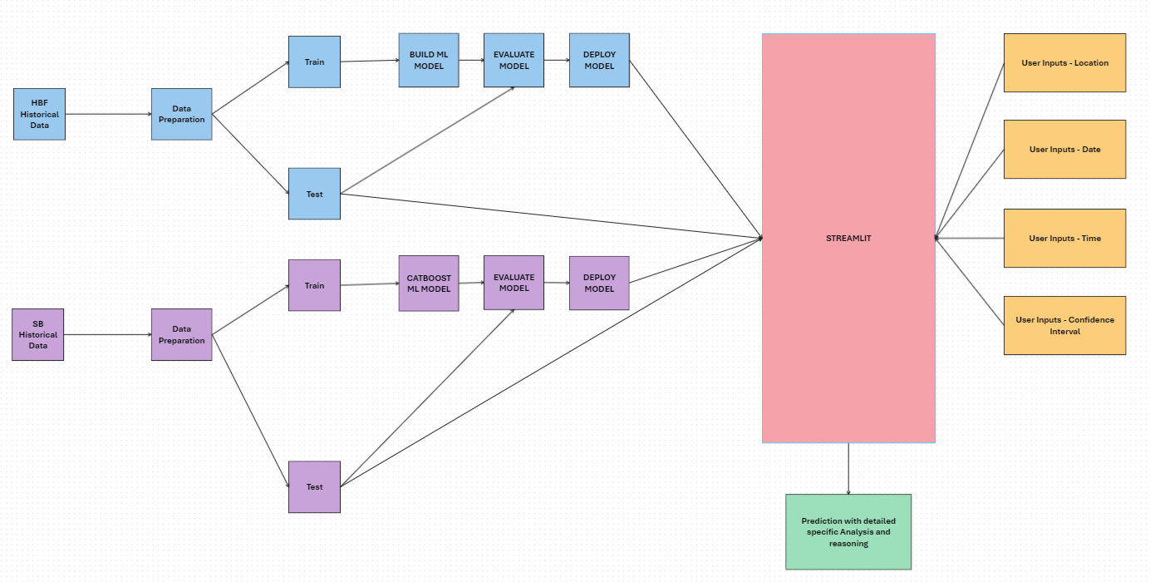
High level implementation plan

Slide 7
ML MODEL Chosen - CATBOOST
Benefit | Description
Handling Categorical Features | CatBoost natively handles categorical features without requiring extensive preprocessing such as one-hot encoding or label encoding.
Performance | CatBoost often outperforms other gradient boosting algorithms like XGBoost and LightGBM on datasets with categorical features, providing better accuracy and generalization.
Ease of Use | CatBoost requires minimal feature engineering, saving time and effort. You simply need to specify which features are categorical, and the model handles the rest.
Speed | CatBoost is designed to be fast both during training and inference, using an efficient implementation of gradient boosting that leverages both CPU and GPU for faster computation.
Robustness to Overfitting | CatBoost incorporates techniques such as ordered boosting, which helps in reducing overfitting and leads to better model performance on unseen data.
Interpretability | CatBoost provides tools for model interpretation, such as feature importance and visualizations of the decision-making process, aiding in understanding how the model uses the features to make predictions.
Handling of Missing Values | CatBoost can handle missing values internally, which is beneficial if your dataset has missing values and you prefer not to impute them manually.
Support for Numerical Features | Although designed for categorical features, CatBoost can still effectively handle numerical features, making it versatile for mixed data types.

Slide 8
PERFORMANCE METRICS – MAE (MEAN ABSOLUTE ERROR)
Reason | Description
Simplicity | MAE is easy to understand and interpret. It represents the average absolute difference between the predicted values and the actual values.
Robustness to Outliers | Unlike metrics such as Mean Squared Error (MSE), MAE is less sensitive to outliers. Large errors do not disproportionately impact the MAE.
Directly Reflects Errors | MAE provides a straightforward measure of prediction accuracy by reflecting the average magnitude of errors in a direct and interpretable way.
Linear Scale | MAE is on the same scale as the data being predicted, making it easier to relate to the actual magnitude of the errors.
Non-negativity | MAE is always non-negative, and a value of 0 indicates perfect predictions, making it intuitive for evaluating model performance.
No Squaring of Errors | Since MAE does not square the errors, it avoids disproportionately penalizing larger errors, offering a more balanced view of model performance across different error magnitudes.
Comparison Across Models | MAE allows for easy comparison across different models or algorithms, as the metric remains consistent and interpretable.
Application-Relevant | For many practical applications, especially those involving resource allocation or logistics, knowing the average absolute error is more relevant than squared or relative errors.

Slide 9


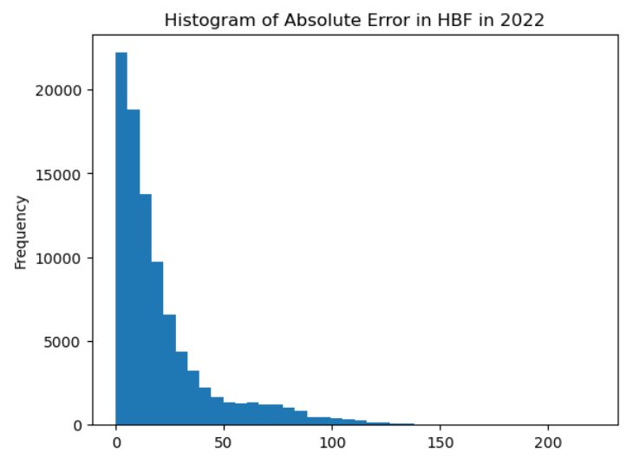
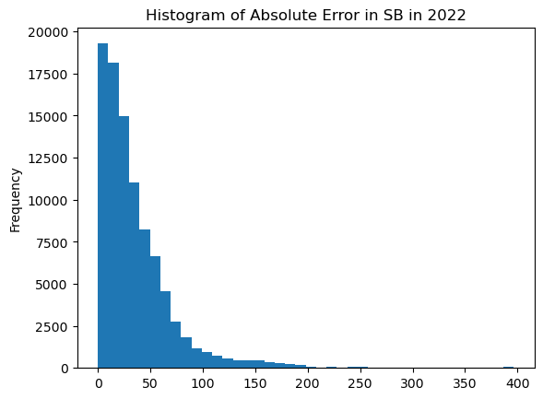
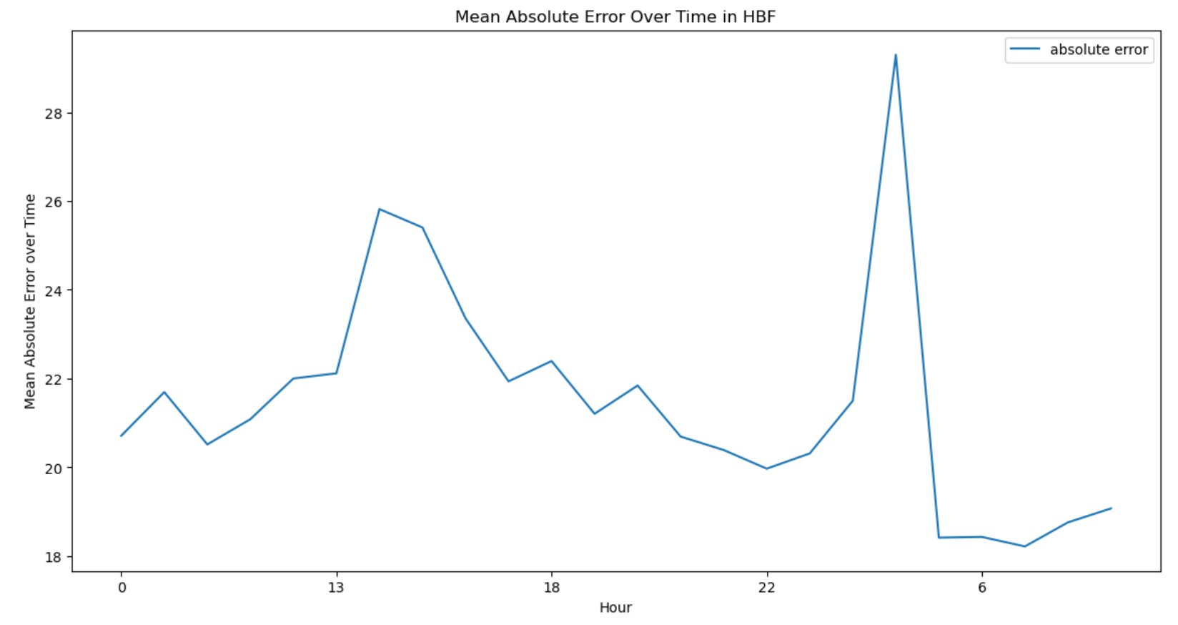
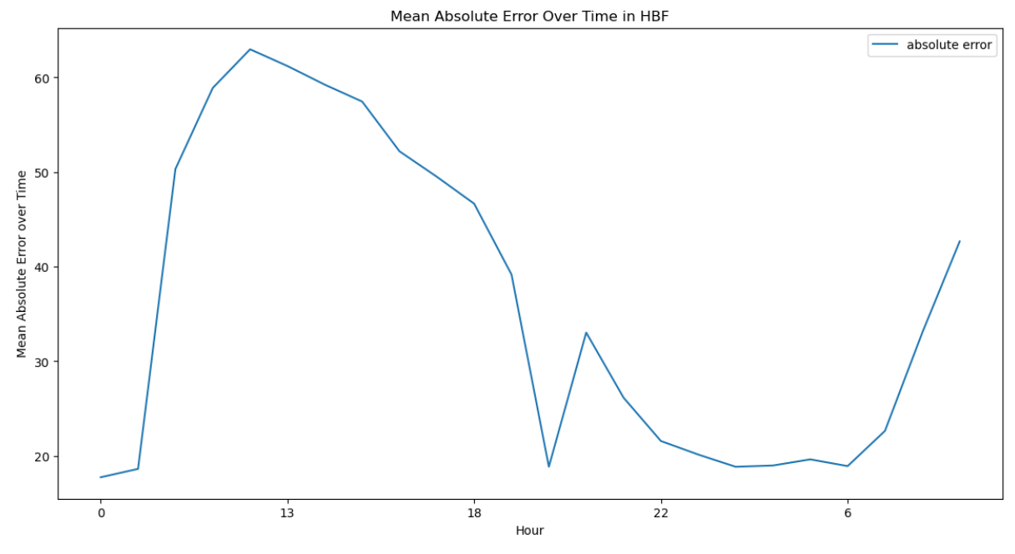
MODEL EVALUATION
MAE for 2022 in HBF – 21.46 (8.88%)
MAE for 2022 in SB – 36.27 (8.2%%)

Slide 10
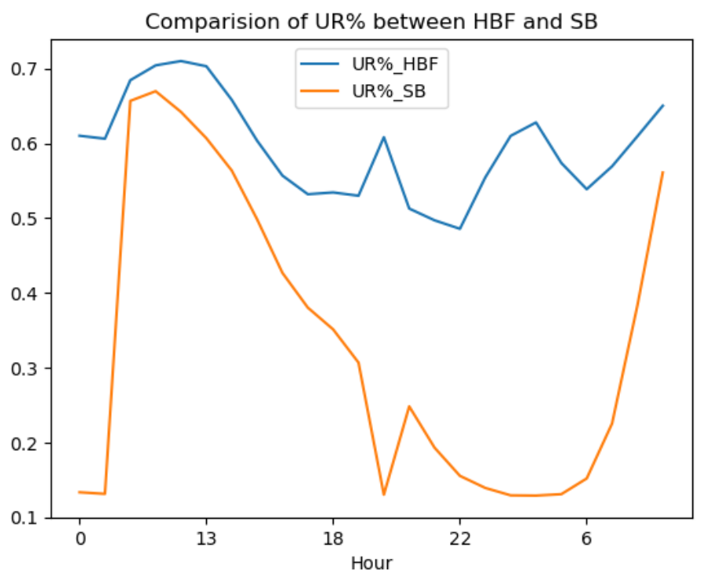
Average Utilization Rates: HBF vs. SB
Average Utilization:
HBF exhibits a higher average utilization rate compared to SB.
Detailed Comparison:
The application will enable users to perform specific utilization rate comparisons for individual dates.

Slide 11
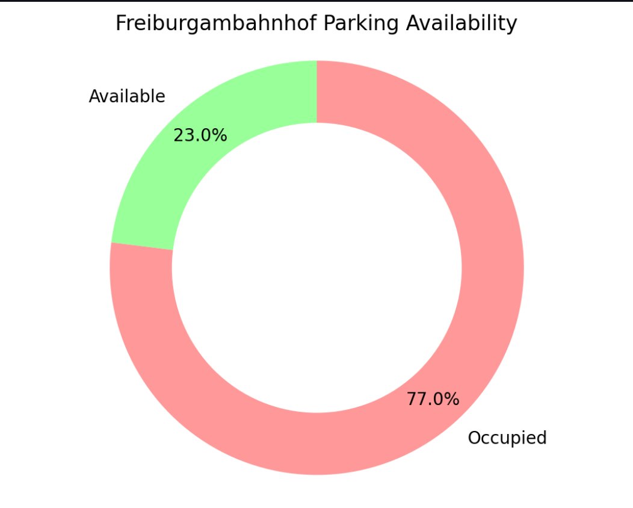

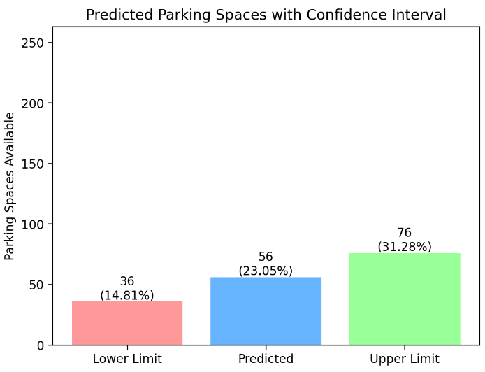
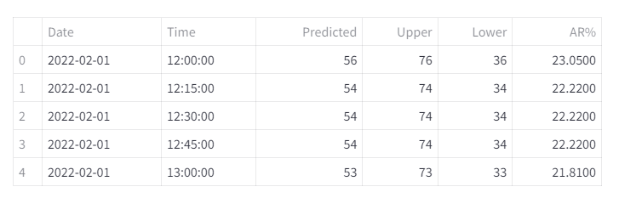
Occupancy for February 1, 2022
Question: Is the occupancy expected to drop below 100 between 12:00 and 1:00 on this date?
Confidence Interval (90%):
Maximum Utilized Spaces: 207 (85% utilization rate), calculated from 243−36
Minimum Utilized Spaces: 167 (68% utilization rate), calculated from 243−76
Utilization Rate Range: 68% to 85%
Conclusion: The occupancy between 12 to 1 will not drop below 100 on this date.
Note: The application focuses on showing parking availability rather than utilization rates. Screenshots and tables in the app will display available parking spots.

Slide 12
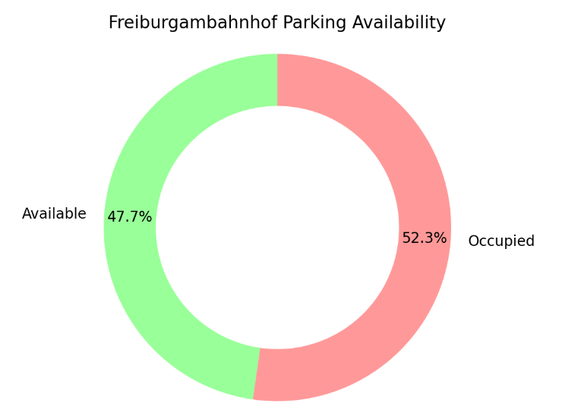
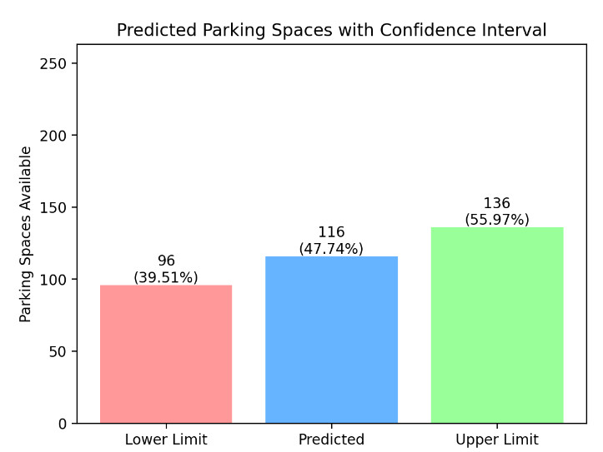
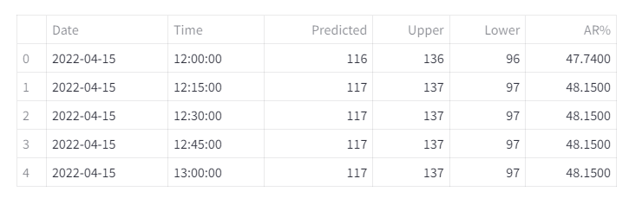
Occupancy for April 15, 2022
Question: Is the occupancy expected to drop below 100 between 12:00 and 1:00 on this date?
Confidence Interval (90%):
Maximum Utilized Spaces: 147 (60% utilization rate), calculated from 243−96
Minimum Utilized Spaces: 107 (68% utilization rate), calculated from 243−136
Utilization Rate Range: 60% to 68%
Minimum Utilization Threshold: Not less than 100 spaces
Conclusion: The occupancy between 12 to 1 will not drop below 100 on this date.
Note: The application primarily displays parking availability rather than utilization rates. Consequently, screenshots and tables focus on availability rates.

Slide 13

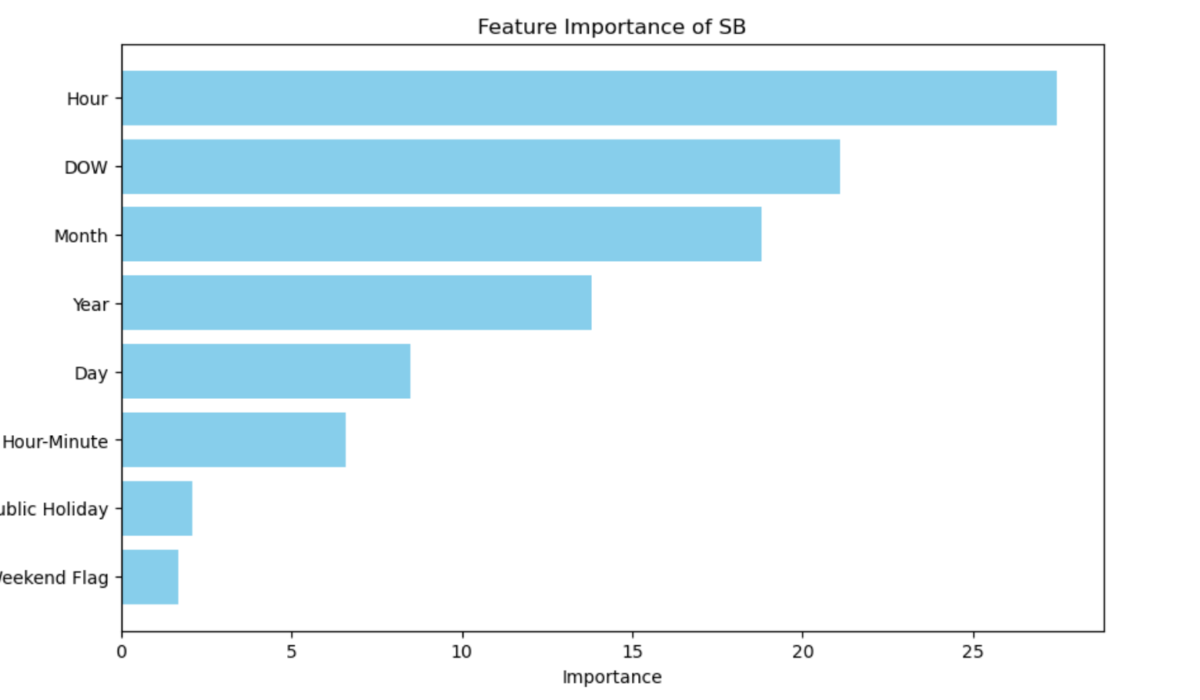
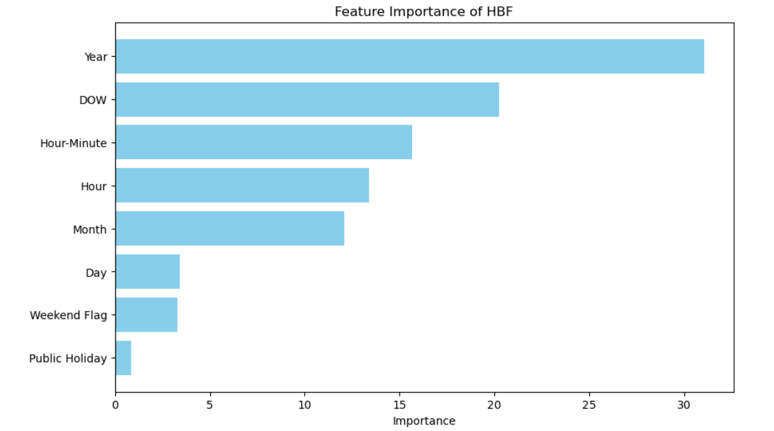
factors which effect parking space
Hour is most important factor when determining the number of parking available spaces for SB when Year is the most important factor when determining the parking available spaces for HBF

Slide 14

FUTURE SCOPE DATA collection
PROPOSAL
#01
Collect comprehensive historical data for all days and time slots consistently.
Incorporate weather features into the dataset.
Include indicators for special events, construction work, transportation limitations, and traffic conditions.
#02
#03

Slide 15
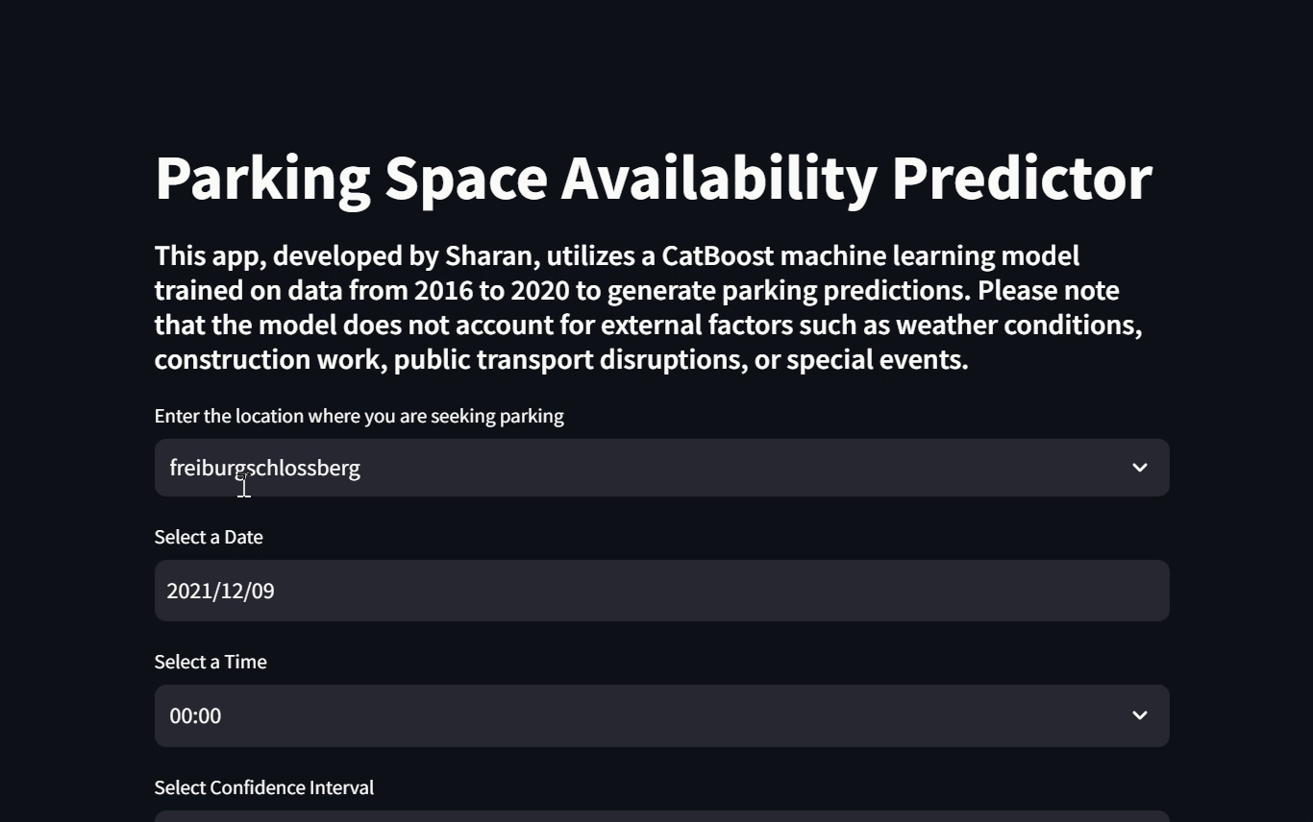

APP Demonstration
Link to the App: https://parkingapp-henkel-sharan.streamlit.app/
Click play

Slide 16
Thank You.

Slide 17
USER STORIES
As a user, I want a parking predictor app that estimates the number of available parking spots for a specific date and time so that I can plan my parking in advance.
As a user, I want to understand the factors that influenced the parking availability prediction so that I can make informed decisions.
As a user, I want to see the predicted range of parking availability with a confidence level for the specified time slot so that I can better gauge the likelihood of finding a parking spot.
As a user, I want to know if I am approaching, currently in, or just past a peak parking time so that I can adjust my arrival time accordingly.
As a user, I want to know which parking locations are expected to have more availability so that I can choose the best option.
As a user, I want to understand the factors influencing parking availability predictions for different locations so that I can make better parking decisions.
As a user, I want to compare the predicted parking availability to actual parking availability so that I can assess the accuracy of the app's predictions.
As a user, I want to enter a date, time, and location into the app and receive a prediction along with a comprehensive analysis of parking availability.
As the company Dream Inc, I want to identify what additional data collection would enhance the accuracy and usefulness of our parking predictor app.
As the company Dream Inc, I want the parking predictor app to be developed and ready for deployment by August 4th, 2024.

